Slide 1
Energy Consumption Analysis and Anomaly Detection
Jose Duran

Slide 2
Project Overview
Objective: This project analyzes energy consumption data from multiple companies across the U.S. to predict usage patterns and detect anomalies like power outages or irregular demand.
Dataset:
Hourly energy consumption data (in MW).
Time span covering several years with detailed temporal features.
Goals:
Use Recurrent Neural Networks (RNNs) to predict energy consumption trends specifically using Long Short Term Memory (LSTM).
Apply Autoencoders to detect anomalies in energy usage.

Slide 3
Energy Consumption Dataset
Energy consumption data from more than 10 energy companies across the U.S.
Rows: Each row represents one hour of energy consumption data.
Columns:
Date and Time: Timestamp in the format MM/DD/YYYY HH:MM:SS.
Energy Consumption: Megawatts (MW) of energy used during the given hour.
Time Period:
Covers multiple years of hourly data, with continuous increments in time.
Ends at a specific point in the dataset (e.g., 2018).

Slide 4
Challenges
Energy use varies by time of day, week, and year.
Outages, unexpected surges, and holidays may disrupt patterns.
Overfitting/Underfitting

Slide 5
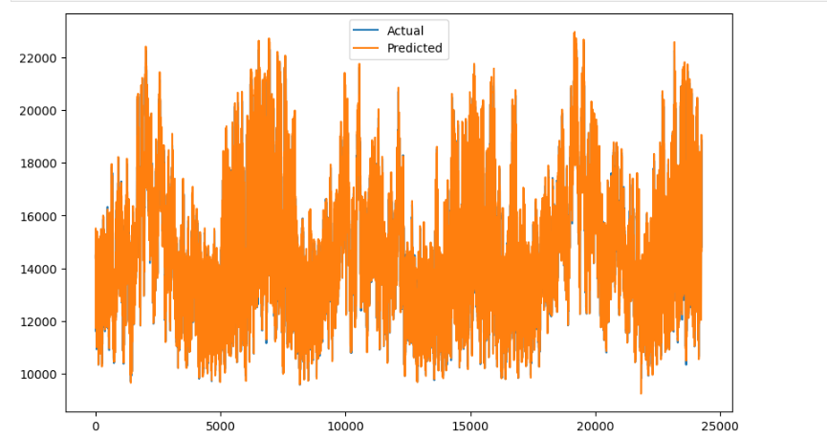
Prediction Analysis using RNNs

Slide 6
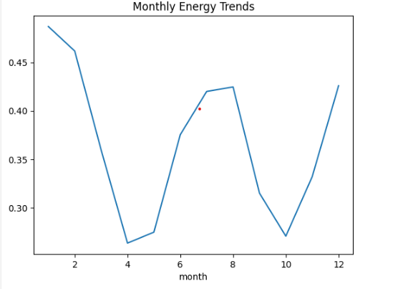
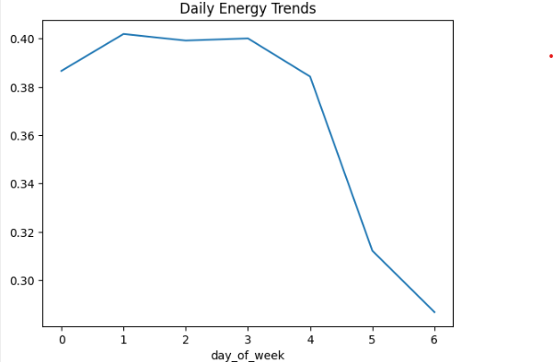
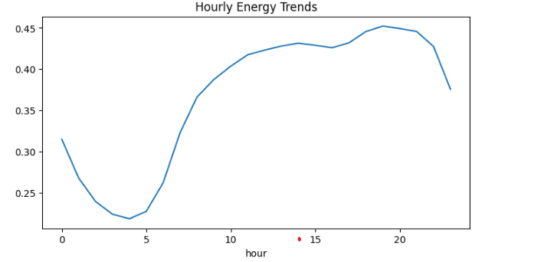
Trend Analysis using RNNs
RNNs retain information from previous steps

Slide 7
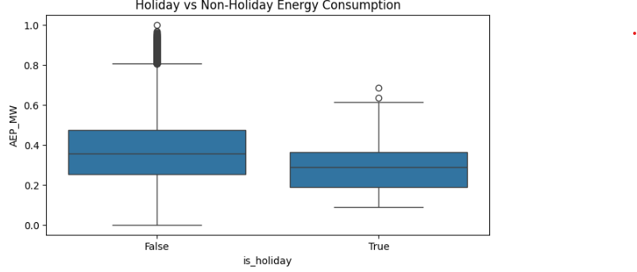
Holiday Analysis

Slide 8
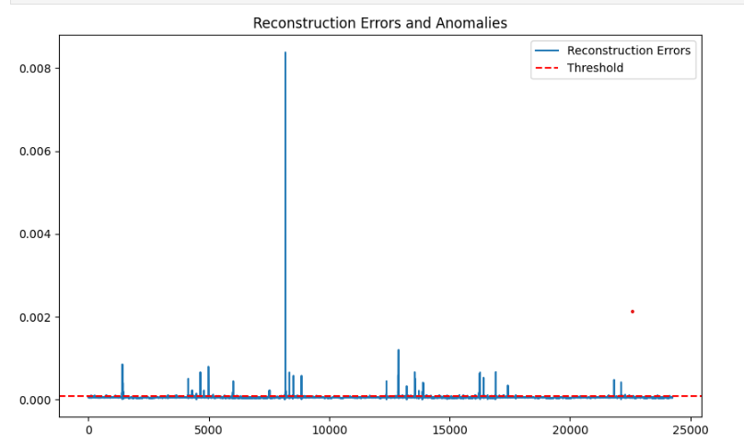
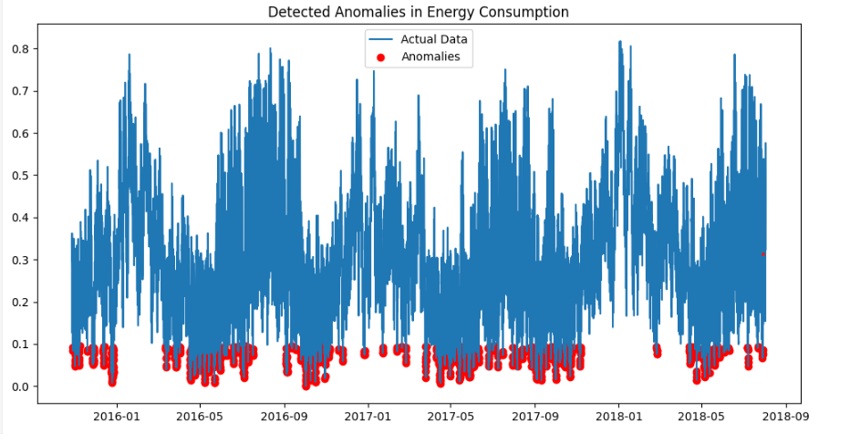
Anomaly Detection
Autoencoders to reconstruct the data and find any outliers
Focus on identifying unusual events or behaviors that predictions alone may miss.
Anomaly threshold: 7.78488817604783e-05

Slide 9
Next Steps
Anomaly Detection for Power Surges
Hyperparameter tuning so that the model is applicable across wide range of data.

